Slide 1
CRE PAPER PRESENTATION
TEAM 1
JUAN ENRIQUE LOPEZ CHAVEZ
LUCAS JERONYMO RIBEIRO

Slide 2

AMAZON PRODUCT SENTIMENT ANALYSIS USING MACHINE LEARNING TECHNIQUES
SOBIA WASSAN; XI CHEN; TIAN SHEN; MUHAMMAD WAQAR; NOOR ZAMAN JHANJHI
82 CITATIONS
MARCH, 2021

Slide 3
SENTIMENT ANALYSIS FOR SPANISH AMAZON PRODUCT REVIEWS

Slide 4
INTRODUCTION
SENTIMENT ANALYSIS IS A KEY NLP TASK THAT CLASSIFIES USER OPINIONS INTO POSITIVE, NEGATIVE, OR NEUTRAL CATEGORIES. IT HAS WIDESPREAD APPLICATIONS IN E-COMMERCE, SOCIAL MEDIA, AND CUSTOMER FEEDBACK ANALYSIS.
WHILE MOST RESEARCH FOCUSES ON ENGLISH TEXTS, THIS STUDY ADAPTS SENTIMENT ANALYSIS TECHNIQUES TO SPANISH DATASETS, ADDRESSING UNIQUE LINGUISTIC CHALLENGES LIKE REGIONAL VARIATIONS, FLEXIBLE SYNTAX, AND IDIOMATIC EXPRESSIONS.
THE STUDY EVALUATES THREE MODELS—MNB, SVM, AND LSTM—PROVIDING A COMPREHENSIVE COMPARISON AND HIGHLIGHTING THE POTENTIAL OF ADVANCED DEEP LEARNING METHODS FOR MULTILINGUAL SENTIMENT ANALYSIS.

Slide 5




KEY OBJECTIVES
ADAPT EXISTING SENTIMENT ANALYSIS METHODOLOGIES DESIGNED FOR ENGLISH TEXTS TO A SPANISH DATASET.
EVALUATE AND COMPARE THE PERFORMANCE OF THREE MACHINE LEARNING MODELS: MULTINOMIAL NAIVE BAYES (MNB), LINEAR SUPPORT VECTOR MACHINE (SVM), LONG SHORT-TERM MEMORY (LSTM) NETWORKS.
ADDRESS THE UNIQUE LINGUISTIC CHALLENGES OF THE SPANISH LANGUAGE, INCLUDING RICH MORPHOLOGICAL STRUCTURES, IDIOMATIC EXPRESSIONS AND REGIONAL VARIATIONS.
ENSURE REPRODUCIBILITY THROUGH DETAILED DESCRIPTIONS OF DATASETS AND PYTHON IMPLEMENTATIONS.

Slide 6
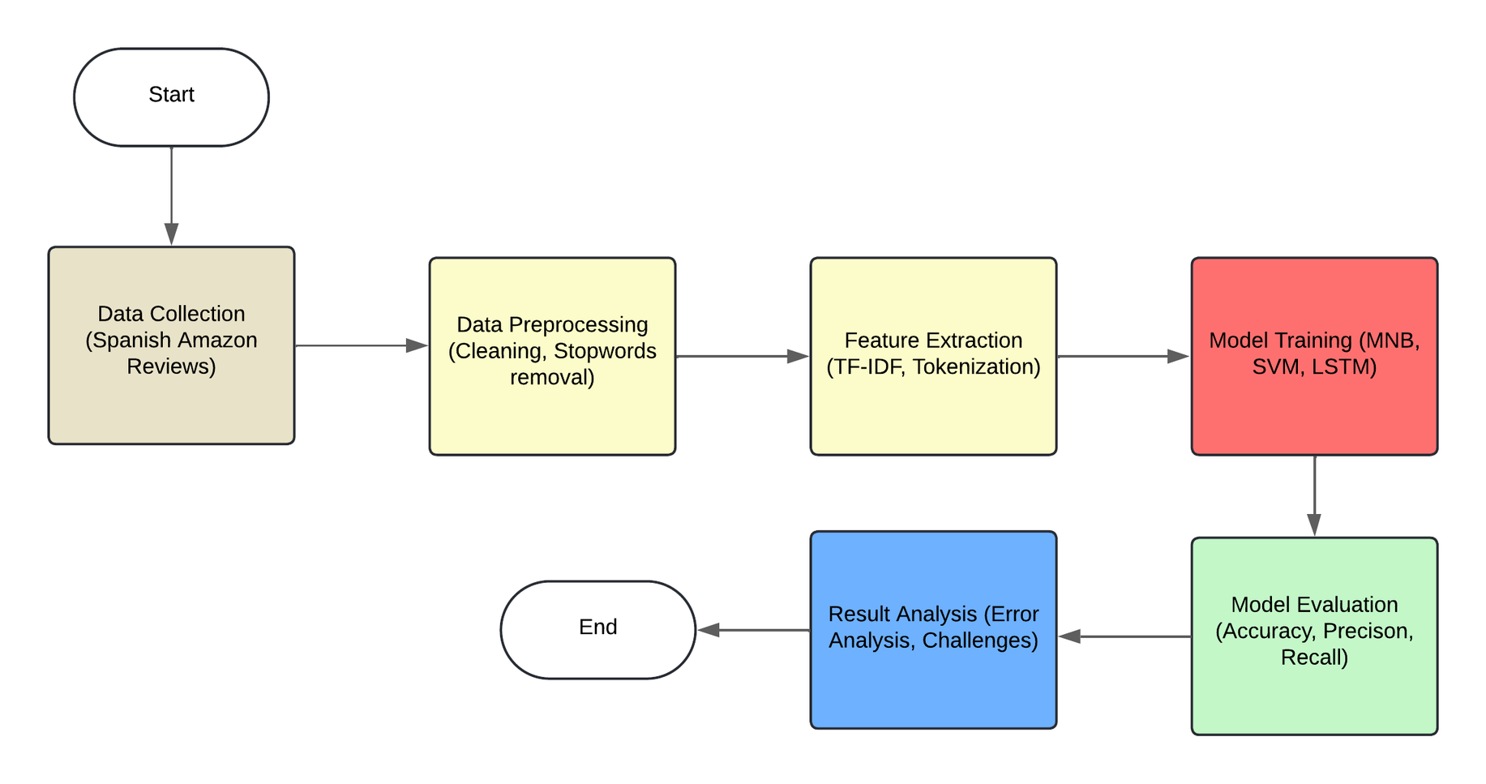
METHODOLOGY

Slide 7
METHODOLOGY
DATA COLLECTION
MODEL TRAINING
The process begins with gathering Spanish-language reviews from Amazon. These are extracted from a dataset that includes diverse regional variations.
Multinomial Naive Bayes (MNB): Uses probabilistic learning based on TF-IDF features.
Support Vector Machine (SVM): Applies a linear kernel for classification.
Long Short-Term Memory (LSTM): Employs a sequential neural network to handle contextual relationships in text.
DATA PREPROCESSING
The collected reviews undergo cleaning to remove noise such as HTML tags, special characters, and stopwords. This step ensures that the data is in a structured and usable form.
MODEL EVALUATION
The trained models are evaluated based on metrics like accuracy, precision, and recall to compare their performance.
FEATURE EXTRACTION
RESULT ANALYSIS
Preprocessed text is converted into numerical representations using techniques like TF-IDF vectorization for traditional models and tokenization with padding for the LSTM model.
This step involves analyzing the models' errors and identifying challenges, such as handling mixed sentiments or regional language variations, and suggesting improvements.

Slide 8
UNIQUE TEAM SLIDE

Slide 9
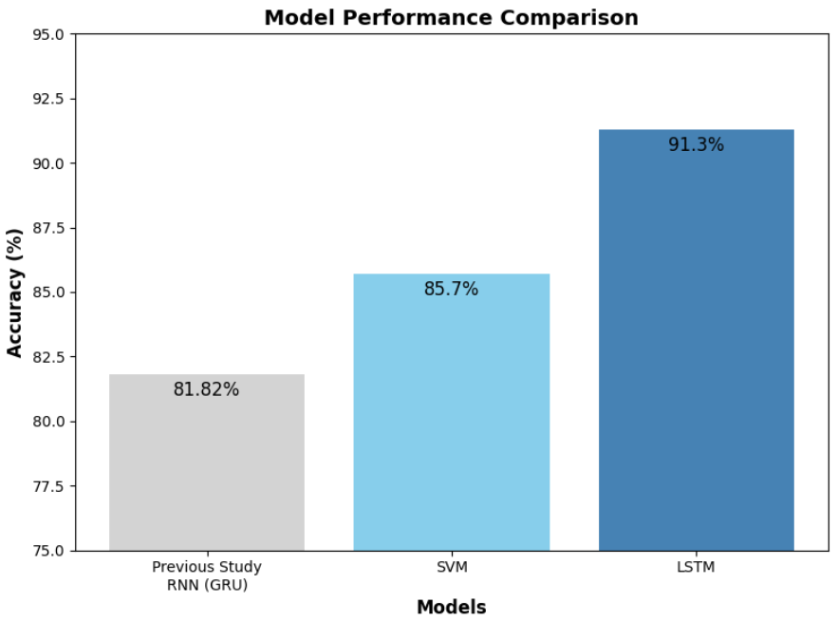
BUILDING UPON PRIOR RESEARCH:
METHODOLOGY REFINEMENTS:
Previous study employed Recurrent Neural Networks (RNN) with Gated Recurrent Units (GRU), achieving an accuracy of 81.82%.
Focused on general sentiment polarity (positive, negative, neutral) with limited adaptation for language-specific challenges.
Enhanced preprocessing techniques (custom stopword removal, TF-IDF, tokenization, and padding).
A broader evaluation framework including metrics like precision, recall, and confusion matrices for better interpretability.
ADVANCEMENTS IN CURRENT STUDY:
Incorporation of Long Short-Term Memory (LSTM) networks, achieving an improved accuracy of 91.3%.
Tailored preprocessing for Spanish, addressing:
Rich morphological structures.
Regional variations and idiomatic expressions.
Comparison of multiple models (MNB, SVM, and LSTM), providing a comprehensive performance evaluation.

Slide 10
KEY FINDINGS
The LSTM model achieved the highest accuracy (91.3%), outperforming MNB (78.5%) and SVM (85.7%), proving its effectiveness in handling complex linguistic patterns and sequential dependencies in Spanish texts.
The study confirmed the applicability of sentiment analysis for Spanish-speaking markets, offering actionable insights for businesses to improve customer experience through targeted responses and regional adaptation.
Language-specific preprocessing significantly enhanced performance by addressing Spanish’s unique morphological structures, idiomatic expressions, and regional variations. Techniques like custom stopword removal and lemmatization preserved semantic context.
Challenges included handling sentences with dual sentiments and regional linguistic diversity, highlighting the need for adaptable preprocessing pipelines.
Performance comparisons showed MNB was biased toward positive sentiments, while SVM provided balanced classifications but struggled with mixed sentiments. LSTM excelled by capturing nuanced sentence structures.

Slide 11



IDEAS FOR FUTURE RESEARCH
INCORPORATING ADVANCED ARCHITECTURES
GRANULARITY IN SENTIMENT ANALYSIS
EXPLORING REAL-TIME APPLICATIONS
Explore attention mechanisms and transformer-based models to enhance the detection of mixed sentiments and better capture contextual nuances within sentences.
Extend the study to classify sentiment at a more detailed level (e.g., aspect-based sentiment analysis) to identify specific product features that drive customer satisfaction or dissatisfaction.
Implement and evaluate sentiment analysis models in real-time environments, such as e-commerce platforms or social media, to understand their scalability and responsiveness.

Slide 12
CONCLUSIONS
This study successfully adapted sentiment analysis to Spanish-language datasets, overcoming challenges like morphological complexity, idiomatic expressions, and regional variations. These findings highlight the importance of language-specific preprocessing for multilingual NLP systems.
The LSTM model demonstrated superior performance, achieving 91.3% accuracy, outperforming MNB and SVM. Its ability to capture sequential dependencies and contextual nuances proves the effectiveness of deep learning in sentiment analysis.
Practical applications include improved customer satisfaction insights, regional adaptation, and enhanced responsiveness. Future work can focus on addressing challenges like mixed sentiments and regional diversity to further refine sentiment analysis systems.

